Slide 1
Analytical techniques - AAS
Unit 1

Slide 2
Subject matter
Analytical Techniques
Analyse mass spectrometry spectra, to determine the isotopic composition of elements, the relative atomic mass of an element and percentage abundances of the isotopes of an element.
Discriminate between absorption and emission line spectra.
Explain that flame tests and atomic absorption spectroscopy (AAS) rely on electron transfer between atomic energy levels.
Analyse flame tests and atomic absorption spectroscopy (AAS) to identify elements and determine the concentration of metallic ions in solution.

Slide 3
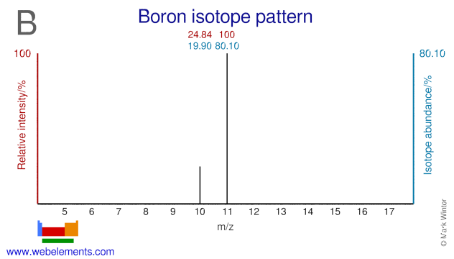
WE DO: Relative Atomic Mass of Boron
$$R.A.M=\frac{\left(abundance \% × atomic mass\right) + (abundance \% × atomic mass)}{100}$$
10.801 u
Notes:
Calculate the relative atomic mass of chlorine using the mass spec results.

Slide 4
Relative ATOMIC MASS
Atomic mass of an element is the weighted average of the masses all of the isotopes of that element.
This is why their atomic mass is never a whole number
Formula:
$$R.A.M=\frac{\left(abundance \% × atomic mass\right) + (abundance \% × atomic mass)}{100}$$

Slide 5
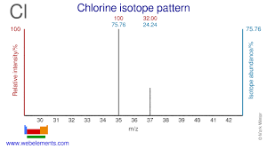
Relative Atomic Mass: Chlorine
35.4848 u
Notes:
Calculate the relative atomic mass of chlorine using the mass spec results.

Slide 6
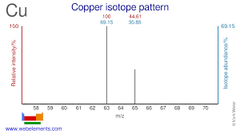
Atomic Mass
The element copper is found to contain two naturally occurring isotopes, shown in the results from a mass spectrometer.
Identify the two isotopes of copper, using isotope notation.
From the relative abundances shown above, calculate the average atomic mass of copper.
Notes:
Solution:
0.6915 x 63 = 43.5645
0.3085 x 65 = 20.0525
Total = 63.617 amu
Round to 63.6 amu

Slide 7
Your turn: Relative Atomic Mass
Element X has two natural isotopes. The isotope with a mass number of 10 has a relative abundance of 20%. The isotope with a mass number of 11 has a relative abundance of 80%.
Calculate the average atomic mass for the element from these figures.
Use this to identify Element X and it’s atomic number.

Slide 8
Atomic absorption spectroscopy
Technique used to determine the concentration of metal ions in a solution.
A flame is used to convert the sample into free atoms.
A light source emits light at a specific wavelength depending on the metal element/s being analysed.
As the light passes through the flame, it is absorbed at specific wavelengths, causing the intensity of the light to decrease.
A detector measures the amount of light absorbed.
A calibration curve is used to determine the concentration of metal ions.

Slide 9
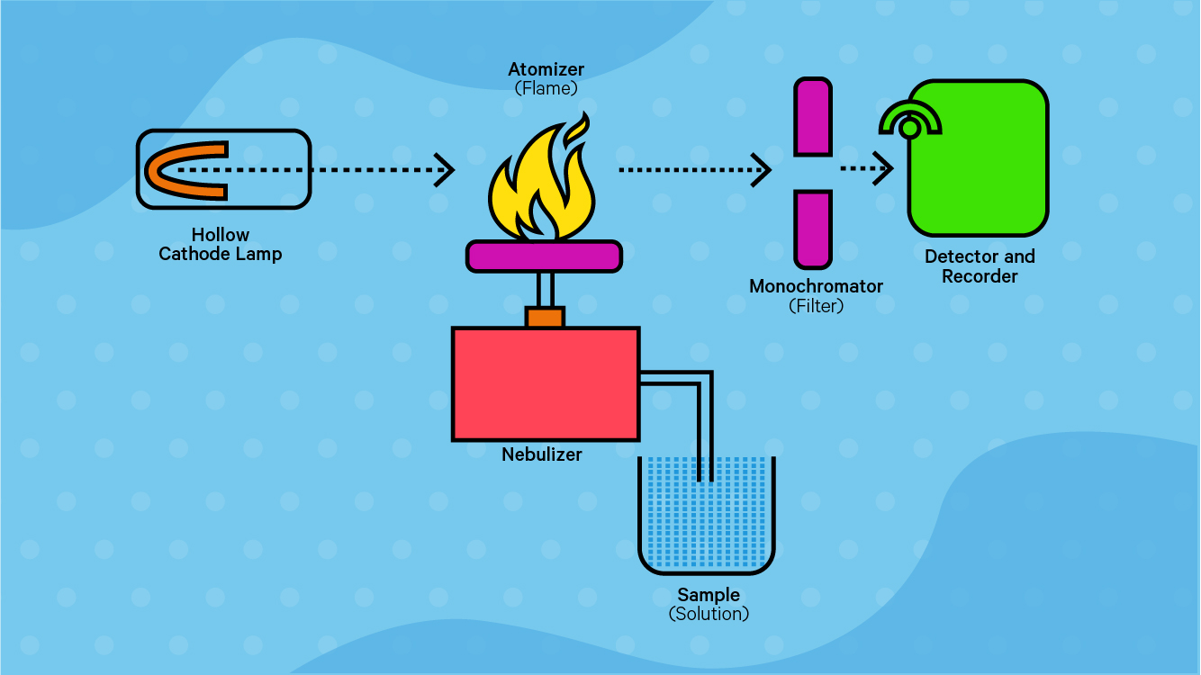
Atomic absorption spectroscopy

Slide 10
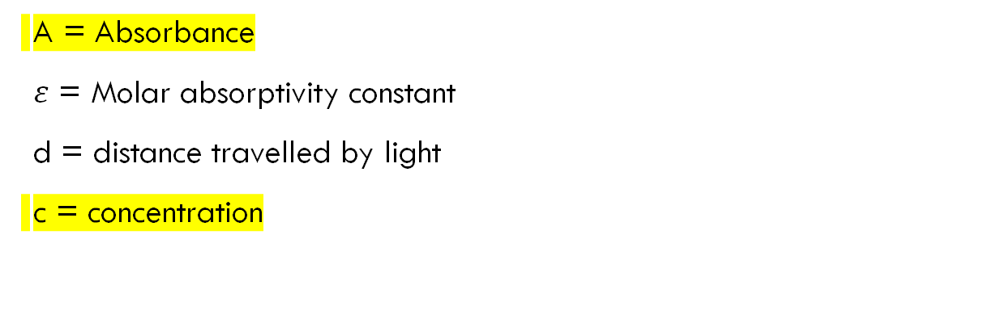

Calibration curves
The concentration of metal ions in a solution is proportional to absorption of light, according to the Beer-Lambert Law.
$$A=εdc$$
A = Absorbance
$ε$ = Molar absorptivity constant
d = distance travelled by light
c = concentration

Slide 11
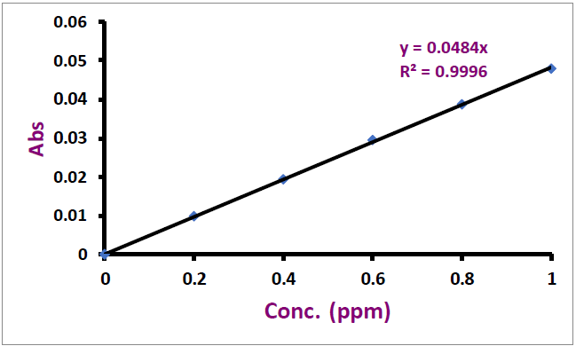
calibration curves
A calibration curve is a line graph that makes it possible to calculate the concentration of metal ions in an unknown solution.

Slide 12
Creating a calibration curve
Calibration curves are created by:
1) Making up a set of “standard solutions” (solutions with known concentrations of metal ions).
2) Using AAS to measure the absorbance at each known concentration.
3) Creating a graph of concentration vs absorbance.
4) Using AAS to measure the absorbance of an unknown solution.
5) Using the equation of the line to calculate the concentration of the unknown solution.

Slide 13
example – calculating concentration of an unknown
The following calibration curve was created for a series of standard solutions containing copper.
An unknown copper solution was measured which had an absorbance of 0.027. Calculate the concentration of copper in the unknown solution.
0.558 ppm

Slide 14
Example – Create a calibration curve
The absorbances for a set of standard solutions containing chromium were measured using AAS. Results are shown in the table below:
Create a calibration curve for chromium. Use the calibration curve to calculate the concentration of a chromium solution with an absorbance of 0.55
= 4.582 ppm
Concentration | Absorbance
0 | 0.001
0.2 | 0.032
0.5 | 0.071
0.8 | 0.098
1 | 0.123

